Slide 1

ENTERTAINER DATA ANALYSIS

Slide 2
Project Details
Title | Entertainer Data Analysis
Technologies | Business Intelligence
Domain | Film and Entertainment
Project Difficulties level | Intermediate
Programming language used | Python, SQL
Others tools | PowerBi, Excel, Jupyter Notebook, MS PowerPoint

Slide 3
Problem statement
Normal life can be stressful, and people need to relax. Being entertained by others is a wonderful way to take some time out of life. It can reduce stress and make life’s issues easier to face. The media and entertainment industry consists of film, television, radio, and print. These segments include movies, TV shows, radio shows, news, music, newspapers, magazines, and books. The entertainment industry is a group of sub-industries devoted to entertainment. The entertainment industry is used to describe the mass media companies that control the distribution and manufacture of mass media entertainment.

Slide 4
Objective
The goal of this project is to develop a Power Bi Dashboard, which can be used for analysis
entertainer’s filmography and their career as well as movie analysis over the years.
Benefits
Entertainer’s filmography can be analyzed with a click
Awards of the entertainers can be consumed by the end-user
Different KPIs will indicate the main information about the entertainer
Movie count trend or rating of the movie trend over the year can be consumed based on the filters applied

Slide 5
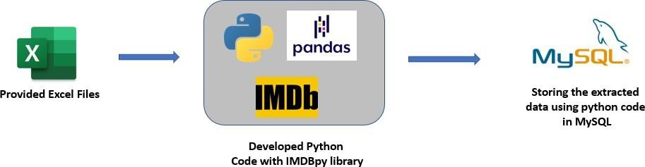
Data preparation Flow
As the provided data is not sufficient for data analysis, I have populated data for the given entertainers and stored them in a local MySQL database using IMDBpy and pandas library.

Slide 6
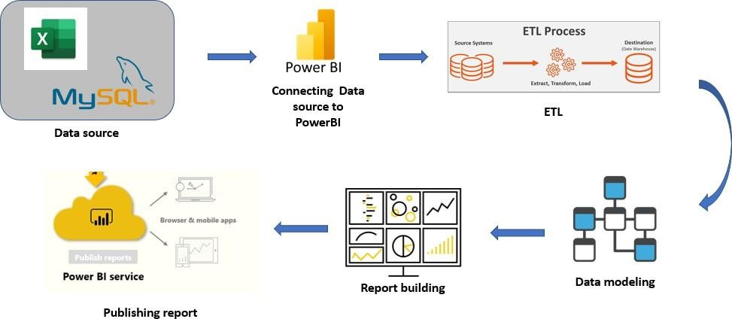
Power BI Architecture
The overall architecture of the project, which was used to build the dashboard

Slide 7
Dataset Information
Provided Dataset:
Entertainer-Basic Info: It consists of a list of 70 Entertainers' Name, Birth years, and Gender
Entertainer-Breakthrough Info: It consists of details about the 70 entertainers like breakthrough year, first major award, breakthrough movie name
Entertainer-Last major work Info: It consists of the details about the 70 entertainers' last majorwork and if died, the Year of death details.

Slide 8
Populated Dataset:
Entertainers_basics_populated:
Name: Entertainer’s name
DOB: Date of birth of the Entertainer
Height: Height of the entertainer
Nicknames: Nicknames of the entertainers, that are used by fans or the cinema industry
Quotes: Entertainers quote or statements they made in public
Mini-biography: Mini-biography of the entertainer
Trademark: Trademark style or behavior of the entertainer
Headshot: URL of the entertainers' headshot
Entertainers_film_list:
Entertainer name: Name of the entertainer
Movie name: The movie name which the entertainer acted
Year: Release year of the movie

Slide 9
Entertainers awards:
Name: Entertainer’s name
Award: Award name
Year: Year of the award
Prize: Type of award
Category: Under which category the award has been given
Result: Whether the entertainer won the award or just a Nominee (Winner/Nominee)
Movie name: For which movie the award was given
Shared_with: If they shared the award with someone, their name
Entertainer salary:
Name: Entertainer’s name
Movie name: Movie name of the salary they received
Year: Movie released year
Salary: Amount they received for that movie

Slide 10
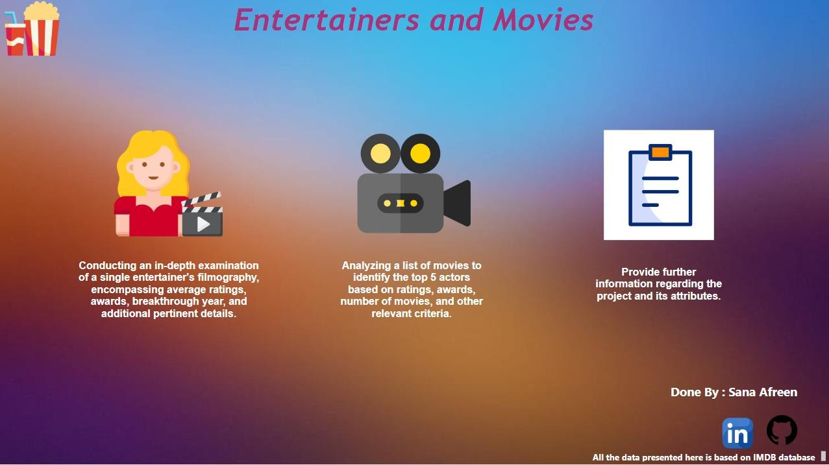
Home Page

Slide 11
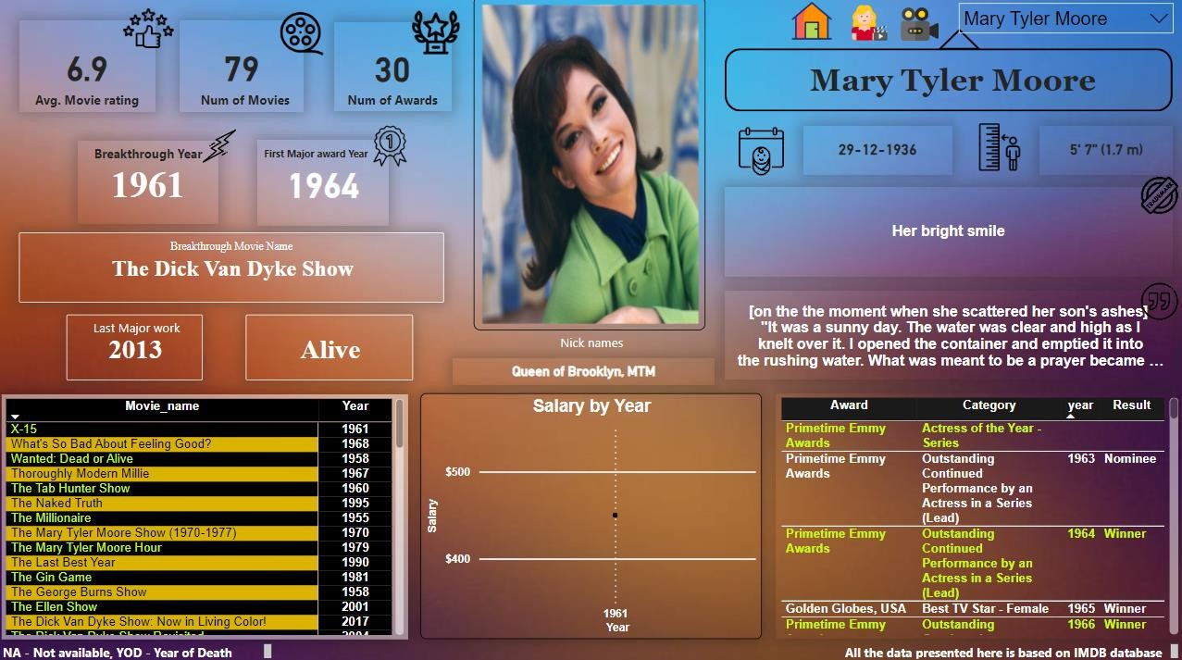
Entertainer Analysis Page

Slide 12
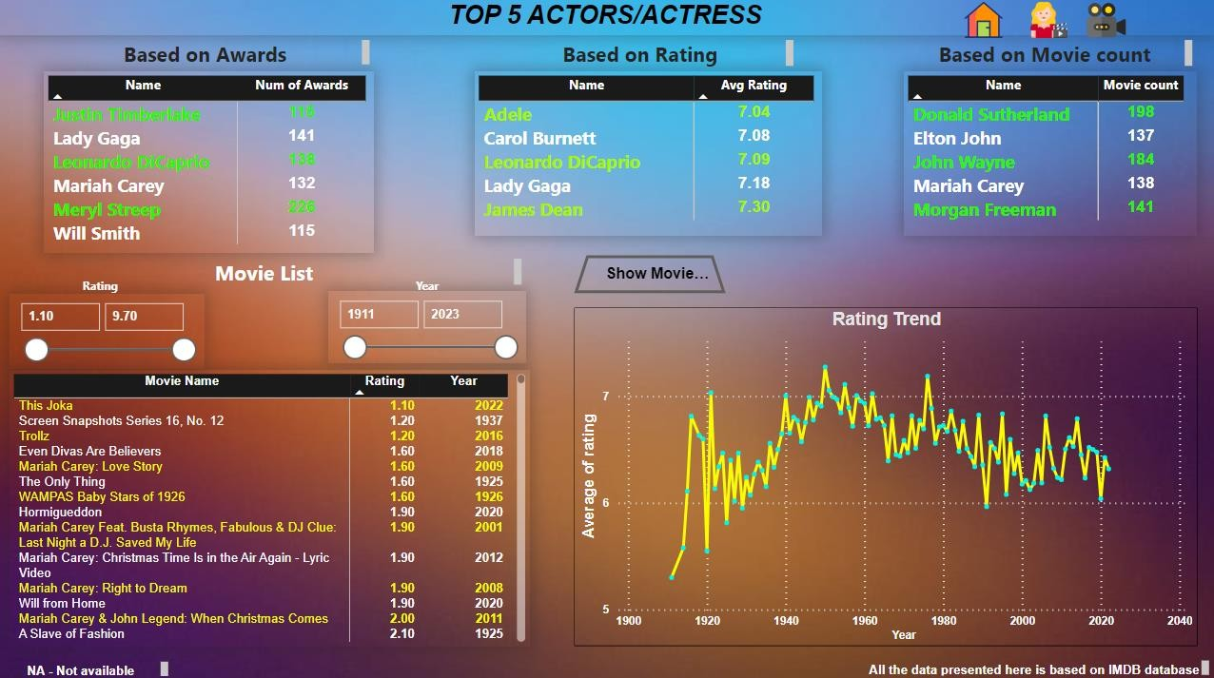
Movie Analysis Page

Slide 13
KPIs (Key Performance Indicators)
Average Movie rating of the Entertainer
Total number of movies acted by the Entertainer
Total number of awards
Breakthrough Movie year
Breakthrough Movie name
First major award year
Date of birth of the Entertainer
Height of the Entertainer
One of the famous Quote of the Entertainer
Trademarks of the Entertainer
Nicknames of the Entertainer

Slide 14
Some of the insights from the Report
Meryl Streep is the entertainer who received the highest number of awards among otherentertainers
Top 6 entertainers who received most of the awards
Meryl Streep
Lady Gaga
Leonardo DiCaprio
Mariah Carey
Justin Timberlake
Will Smith
James Dean has the highest average rating of movies among others
The highest number of movies (55) released to date was in 1998
The highest average rating of movies was in 1949
Donald Sutherland acted in the highest number of movies to date, which was 198 movies

Slide 15
As it is an entertainer’s analysis project, based on the end-user need they can consume a lot of insights from the dashboard.
For the filtering purpose based on the end user need, on the entertainer's analysispage, there is a drop-down filter to select the particular entertainer.
In the Movie analysis page, Include several filters like rating and year, so theend user can filter the data according to their interest

Slide 16


